Slide 1
Identifying players in broadcast sports videos
Supervisor: DR. APHRODITE GALATA
Haorui Chen

Slide 2
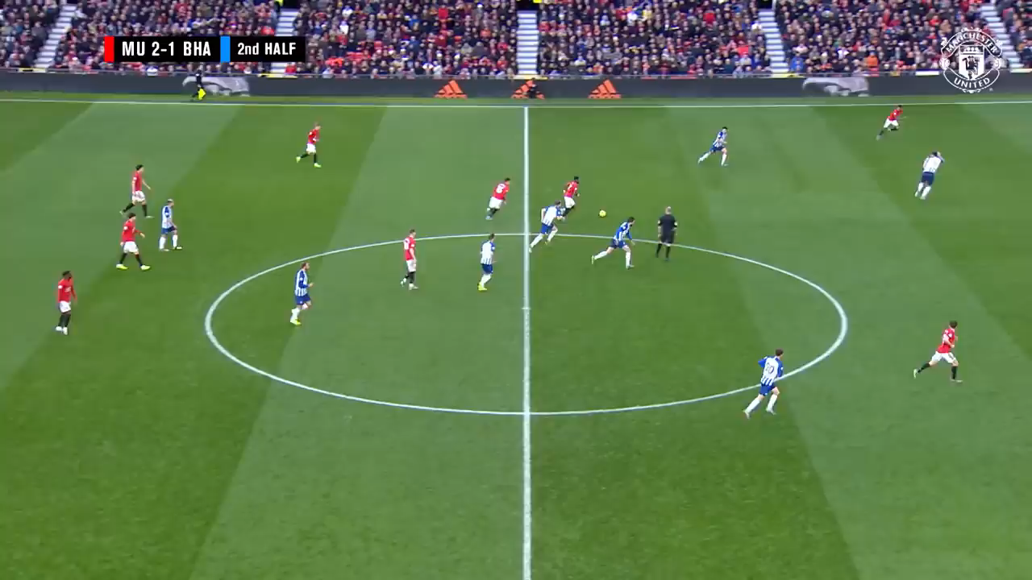

Slide 3
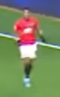

Who scored the goal ?
Who is he ?

Slide 4
Why is it useful?
Looking for possible tactics taken by opponents
Currently: manual review of matches
Ideally: automatic tactic generation
prerequisite
Trajectory & Identity

Slide 5
GOAL
A box always around each player
Correct and consistent identification
Keep location info

Slide 6
Components
Implementation
0. model for detection and identification
1. 1st iteration:
detect, classify, assign to tracklets
2. correct, filter
3. 2nd iteration:
draw tracklets
1. player detection
2. player classification
3. tracking
4. label correction

Slide 7
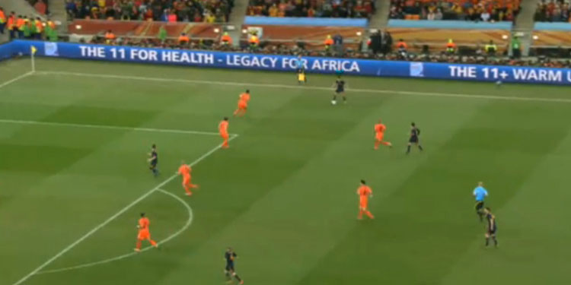
Series of bounding boxes
Tracklet
Tracklet

Slide 8
Current version

Slide 9
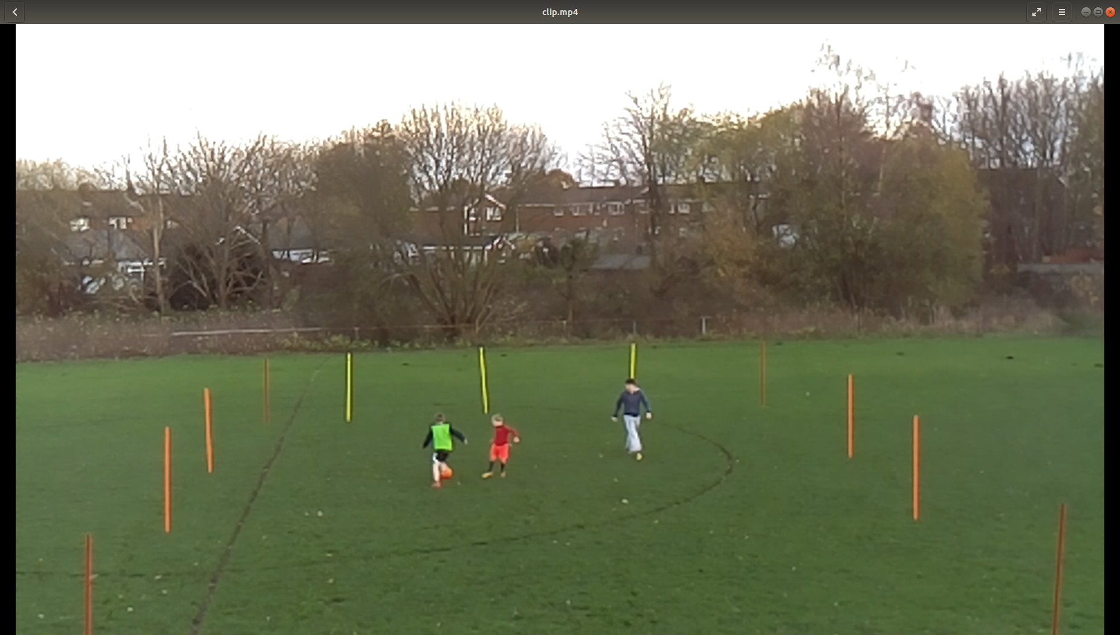
1. player detection
HOG+SVM

Slide 10
Evaluation method:
precision = # of correct detections/# of total detections
recall = # of correct detections/ # of expected detections

Slide 11
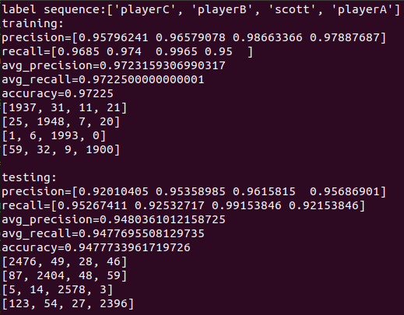
2. Player classification
Confusion matrix
1st VSM: on MSER+SIFT features
Kmeans to build BOVW model
2nd VSM: on VW histograms
K-NN classification on VW histogram

Slide 12
3. tracking
Method: tracking by detecting
Perdict → detect → match
Kalman filter
Euclidean distance

Slide 13
4. Label correction
Most frequent label across the whole tracklet

Slide 14
Evaluation method:
Accuracy = # of correct detections / # of total detections
Correct detection: detection at with right label and at right place
Right place: % of intersection between detection and actual place over a threshold

Slide 15
Historical version

Slide 16
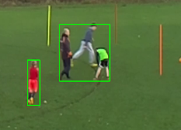
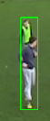
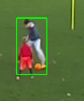
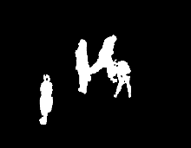


1. Object detection
1.1 background subtraction
Do not generalize
Vulnerable to occlusion
Do not detect static figure

Slide 17
1.2 pretrained HOG+SVM
# of detections not enough for prediction
Reason: trained on pedestrians
Figures in training sets roughly at the same size

Slide 18
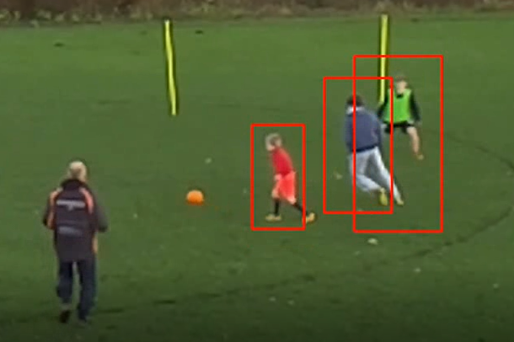
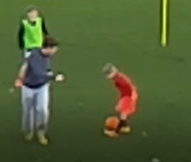
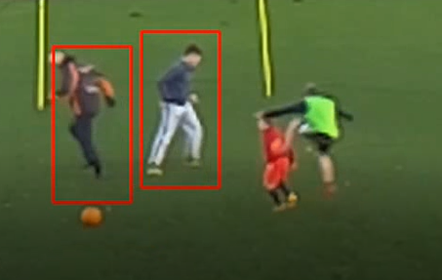
Vulnerable to scale
Vulnerable to motion
Detection failure

Slide 19
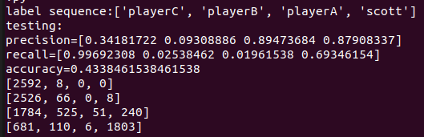
2.1 Rgb histogram
2. Object detection

Slide 20
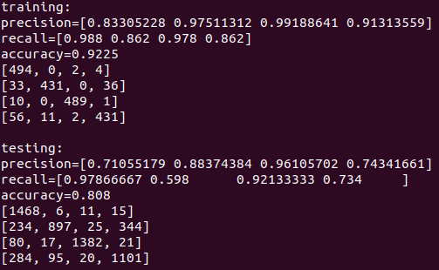
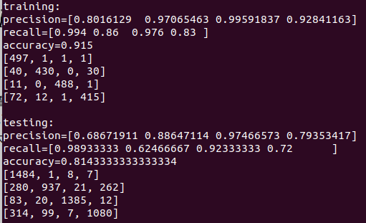
2.2 SIFT-based BOVW HISTOGRAM
Experiments on BOVW size
Size = 50
Size = 63

Slide 21
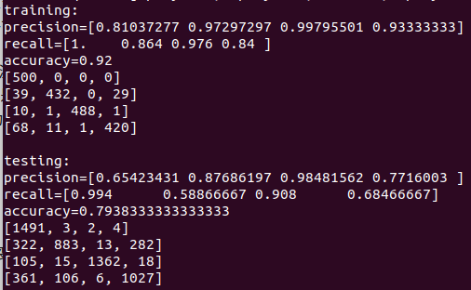
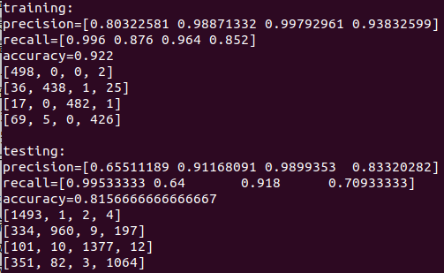
2.2 SIFT-based BOVW HISTOGRAM
Experiments on BOVW size
Size = 70
Size = 75

Slide 22
Plan till 3.20
Try to solve occlusion problem by adding more training examples
Adjust parameters of tracking system to get better tracking
Try the program on different videos to see robustness

Slide 23
3. Tracking
Key points:
Tracklet
Kalman Filter
Predicted location
① predict according to historical info
② detect
③ combine info
( weighted average )
Previous location
(in tracklet)

Slide 24
3. Tracking
Key points:
Tracklet
Kalman Filter
Predicted location
① predict according to historical info
② detect
③ combine info
( weighted average )
Detected location

Slide 25
3. Tracking
Key points:
Tracklet
Kalman Filter
Final location
① predict according to historical info
② detect
③ combine info
( weighted average )

